Slide 1

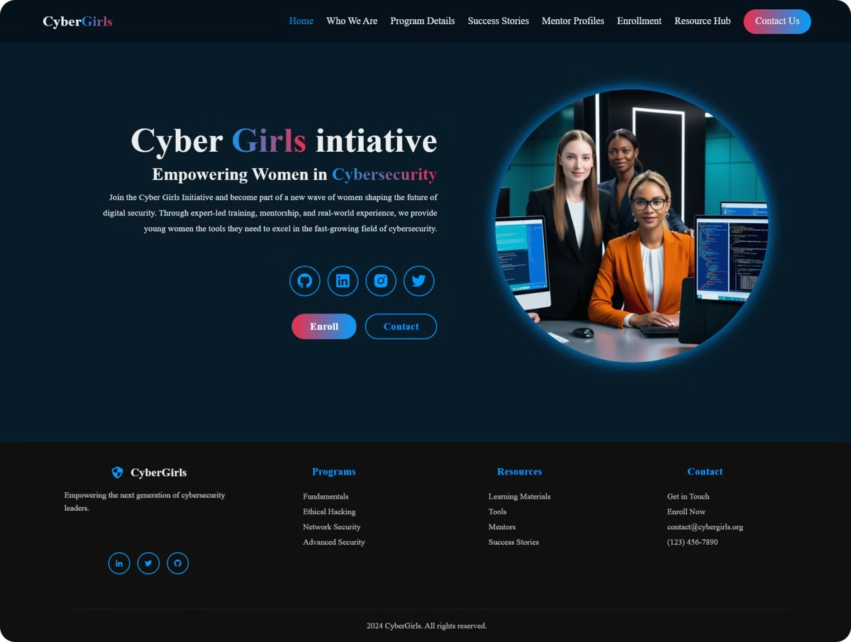
CyberGirls Web Design: A Modern, Modular Approach
This presentation delves into the design and development of the CyberGirls website, highlighting its key features and functionalities. We'll explore the design framework, UI components, and responsive design elements, along with the technical structure and navigation.

Slide 2
Design Framework & Architecture
Modular Structure
Vanilla Tech Stack
Responsive Design
The project employs a clean and modular design, utilizing separate HTML files for distinct sections. This promotes organization and allows for easy maintenance and updates.
The website leverages vanilla HTML, CSS, and JavaScript without relying on heavy frameworks. This prioritizes performance and simplicity, ensuring a fast and efficient user experience.
A mobile-first approach guides the design process, prioritizing user experience on various screen sizes and devices. Responsive design ensures optimal readability and functionality across all platforms.

Slide 3
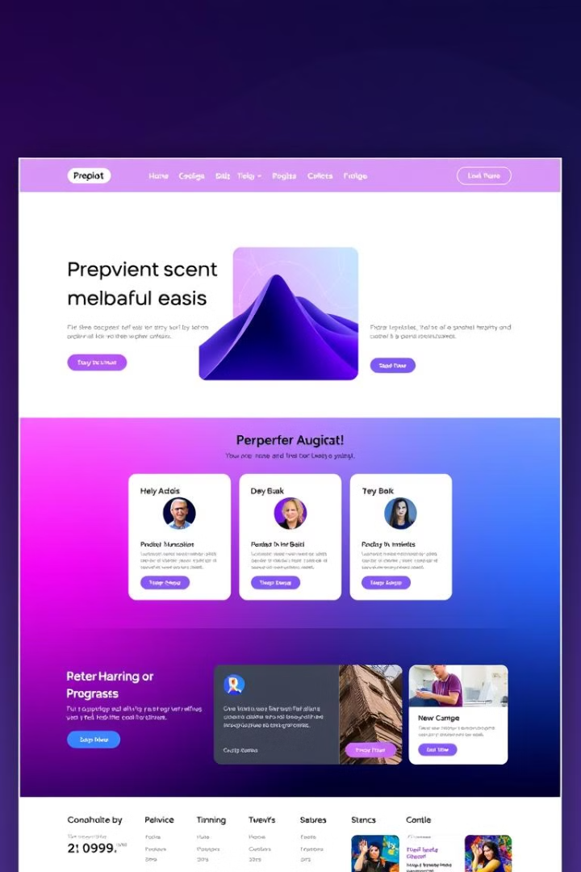
UI Components and Layout
1
Navigation
2
Hero Section
The navigation system is intuitive and responsive, adapting seamlessly to different screen sizes with a user-friendly hamburger menu.
The hero section features prominent imagery, captivating users with a visually engaging introduction and compelling calls to action.
3
Card-Based Layout
4
Design Elements
Program, mentor, and resource information is presented in a clear and concise format using card-based layouts, enhancing readability and accessibility.
Gradients, a modern color scheme, and responsive grid systems contribute to a visually appealing and organized layout.

Slide 4
Design Elements: Color and Typography
Color Scheme
Typography
The website utilizes a dark primary background (#081b29) for a modern and sophisticated aesthetic. Accent colors, #009FFF (blue) and #ec2F4B (red), add visual interest and contrast.
The Poppins font family ensures clean, modern readability, while responsive font sizing using rem units adapts to different screen sizes. Hierarchical typography is implemented for visual clarity.

Slide 5
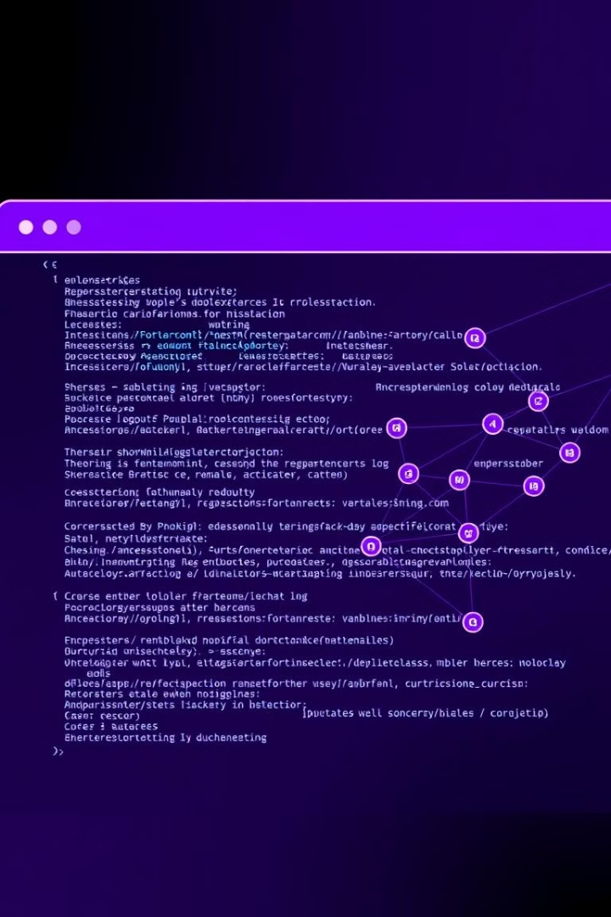
External Plugins and Libraries
Boxicons
Minimalist Libraries
Modern, scalable icons from the Boxicons (v2.1.1) library enhance the website's visual appeal and provide a consistent iconography system.
The website avoids heavy JavaScript frameworks, prioritizing a lightweight and efficient user experience. Custom JavaScript is used for interactive features.

Slide 6
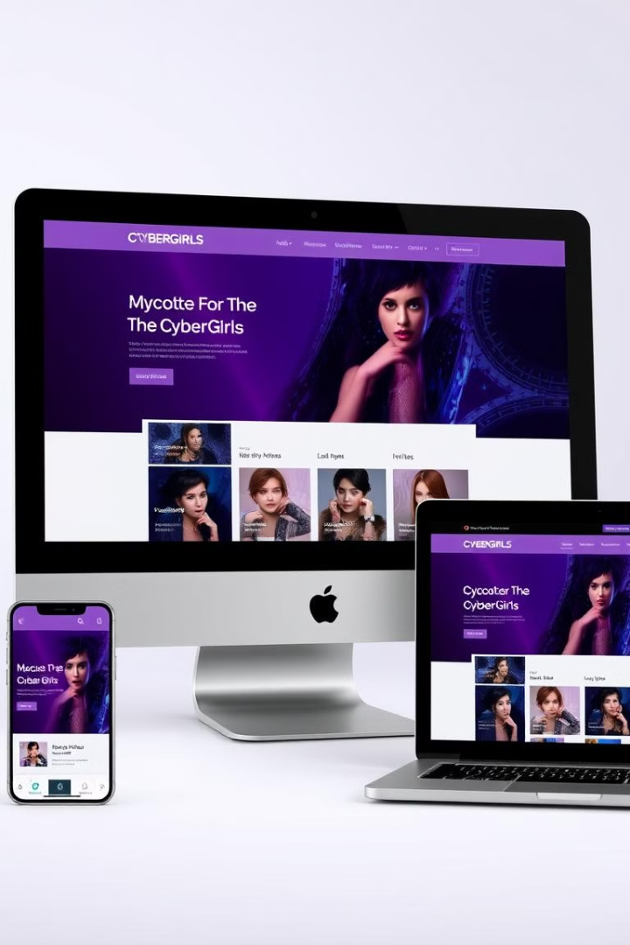




Responsive Design Features
Fluid Layouts
Mobile Optimization
CSS Grid and Flexbox enable fluid layouts that adapt seamlessly to different screen sizes, ensuring a consistent user experience across devices.
The website is optimized for mobile devices below 576px, providing an exceptional user experience on smartphones.
Tablet Optimization
Desktop-First Approach
A dedicated breakpoint at 800px ensures optimal display and functionality on tablets, enhancing user experience on larger screens.
A desktop-first approach is employed, allowing for graceful degradation to ensure compatibility across different screen sizes and devices.

Slide 7
Key Files and Directory Structure
HTML Pages
Assets & Styles
JavaScript
index.html: Landing Page
Assets Directory: All Image Assets
script.js: Interactive Functionality
about.html: Initiative Info
Styles Directory: Single style.css file
programs.html: Courses and Programs
stories.html: Success Stories
mentors.html: Mentor Profiles
enrollment.html: Registration
resources.html: Learning Materials
contact.html: Contact Us

Slide 8

Benefits of Modular Design
Scalability
Maintainability
Easily add or remove content without affecting other sections
Easier to update and fix issues in specific parts of the site
Reusability
Collaboration
Components can be used across multiple pages, saving time and resources
Multiple developers can work on different parts of the site simultaneously

Slide 9
Page-Specific Structures
1
Home Page
The home page features a hero section with a split layout, highlighting key information and calls to action.
2
About Page
The about page provides details about the CyberGirls initiative, including its mission, vision, core values, and organization description.
3
Programs Page
The programs page showcases available courses and programs, providing information on training details and course descriptions.
4
Stories Page
The stories page highlights success stories and testimonials, showcasing the impact and achievements of the CyberGirls initiative.
5
Mentors Page
The mentors page features mentor profiles, detailing their expertise, professional backgrounds, and contributions to the initiative.
6
Enrollment Page
The enrollment page guides users through the registration and application process, providing clear instructions and information.
7
Resources Page
The resources page offers a comprehensive collection of learning materials, tools, and educational content to support users' learning journey.
8
Contact Page
The contact page provides contact information, communication channels, and convenient options for users to get in touch.

Slide 10
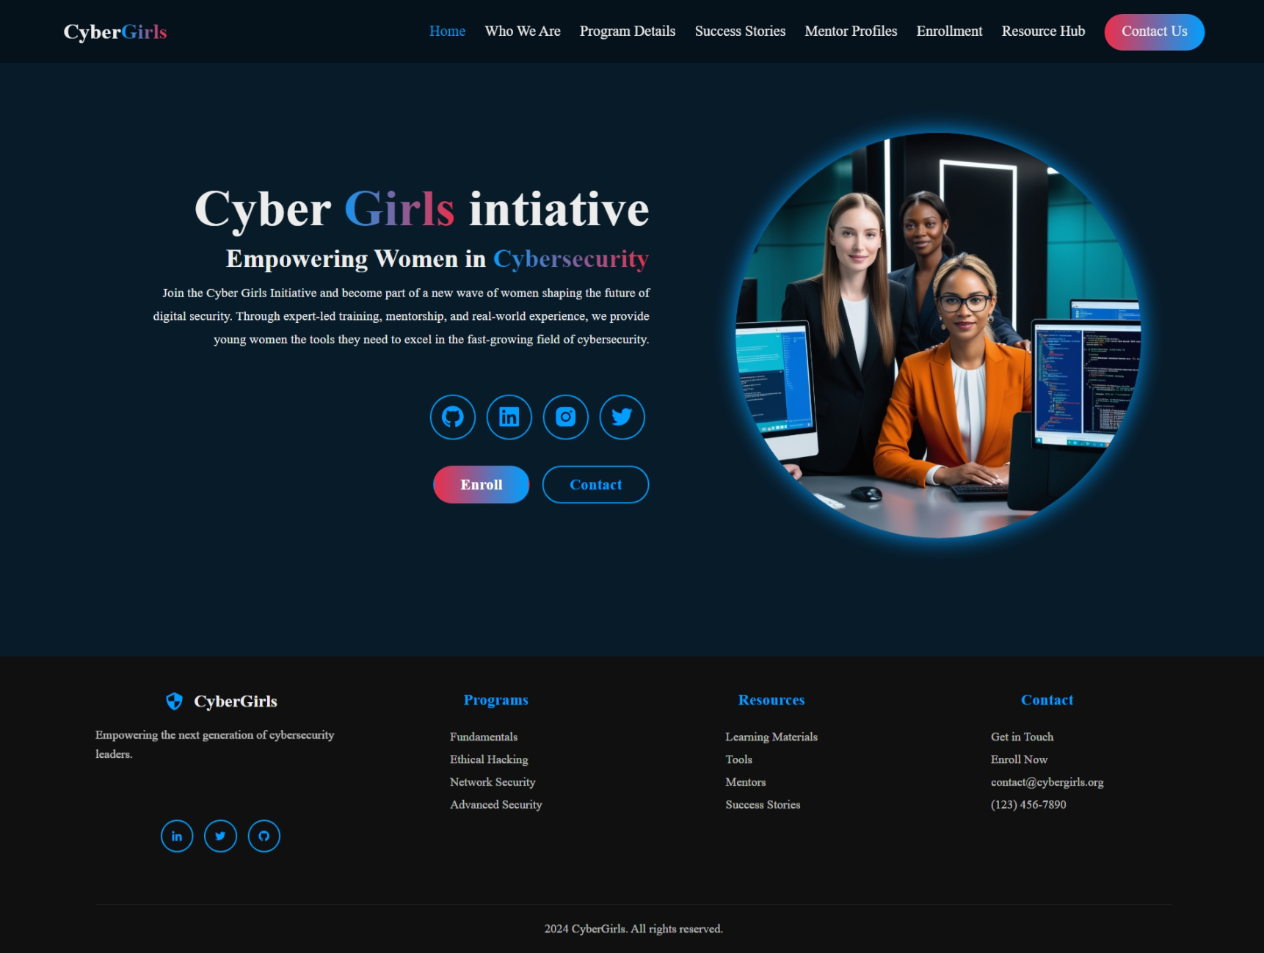
Home Page Structure
Home Page - index.html
Hero section with a split layout and circular hero image.
Includes a main heading, subheading on cybersecurity, and mission paragraph.
Features social media icons and two CTAs: "Enroll" and "Contact."

Slide 11
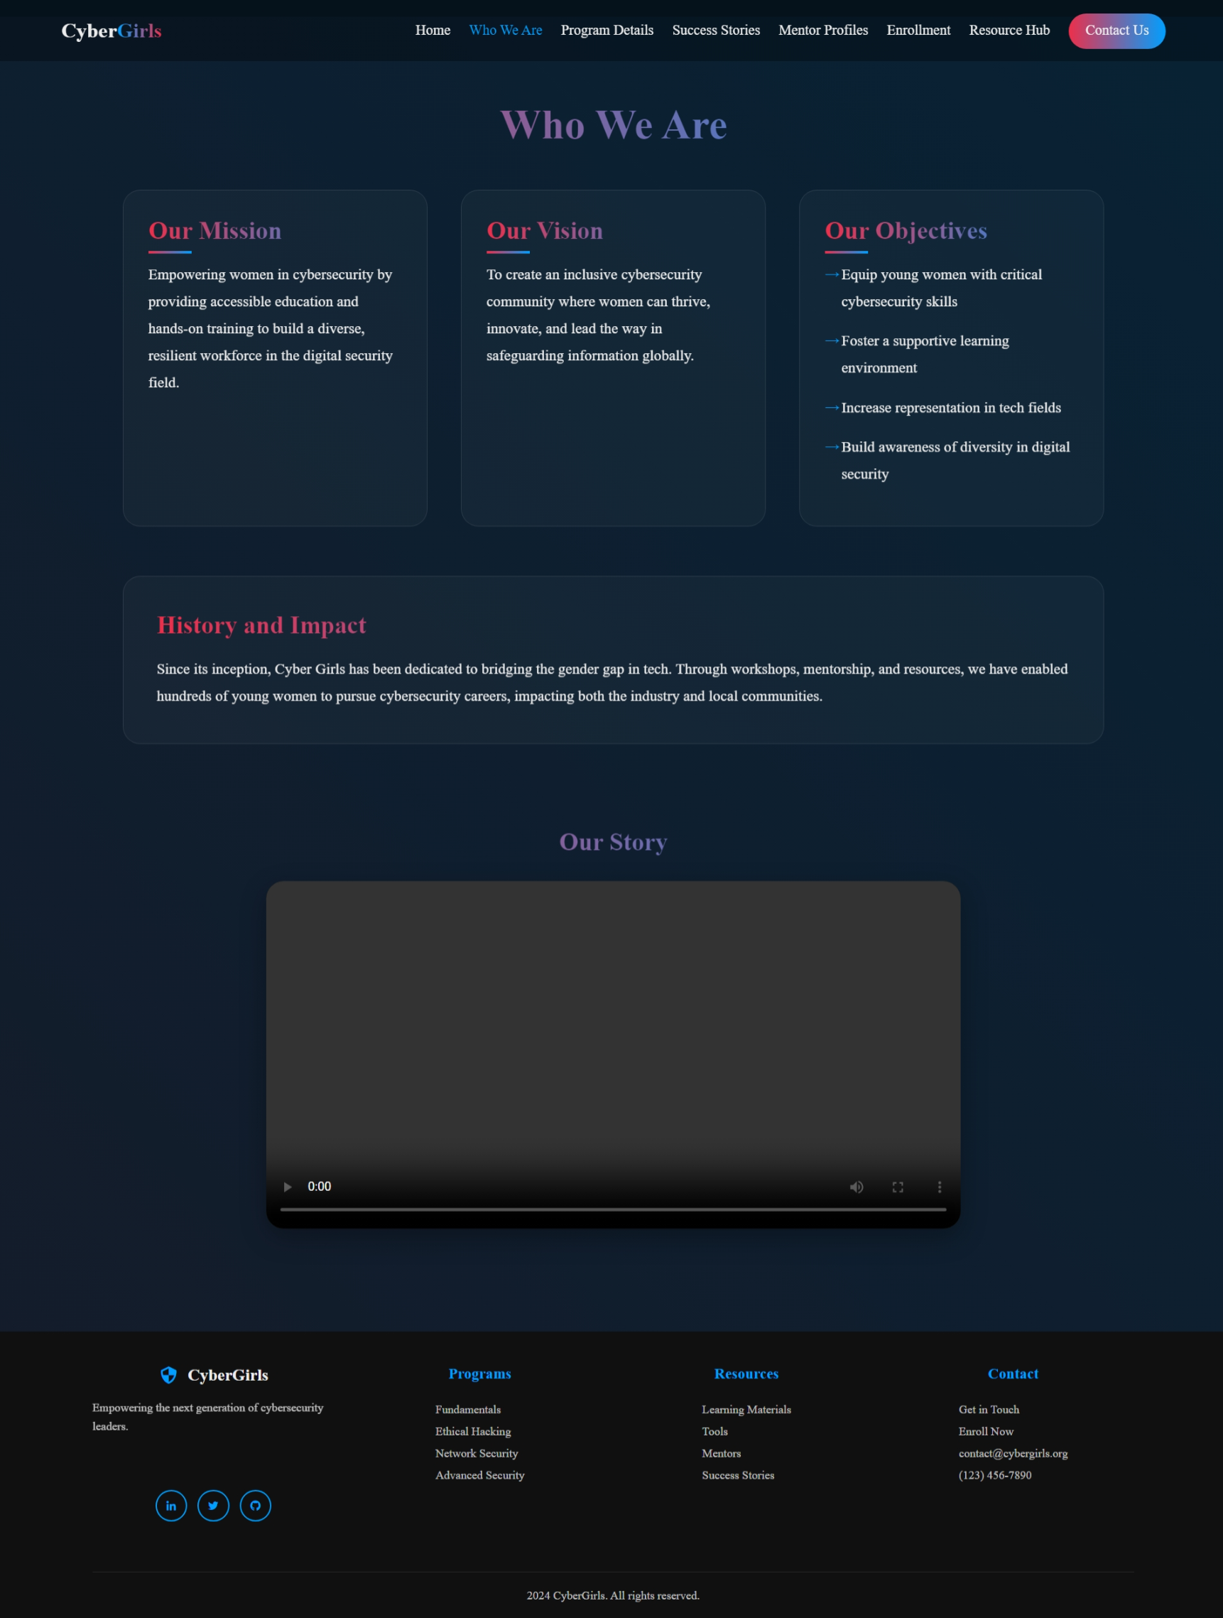
About Page
About Page - about.html
About Page - about.htmlThe "Who We Are" section presents:Main
HeadingMission and Vision statements
Core values and organization description Emphasizes the mission to inspire, educate, and empower individuals in cybersecurity.

Slide 12
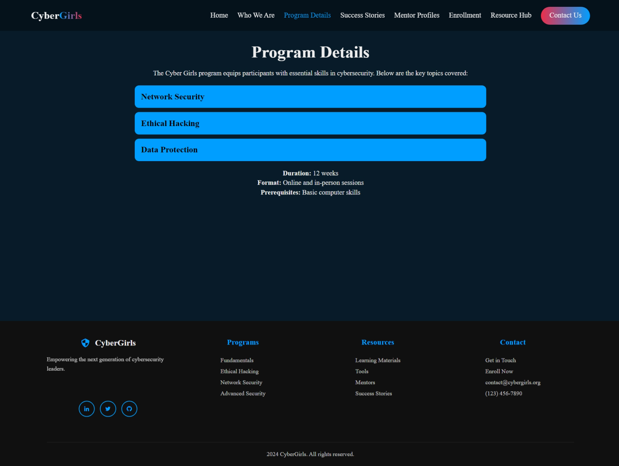
Programs Page
Programs Page - programs.html
Showcases available programs and courses, featuring:
Course listings with descriptions
Details on training schedules and objectives
Offers a structured overview of opportunities for personal and professional growth.

Slide 13
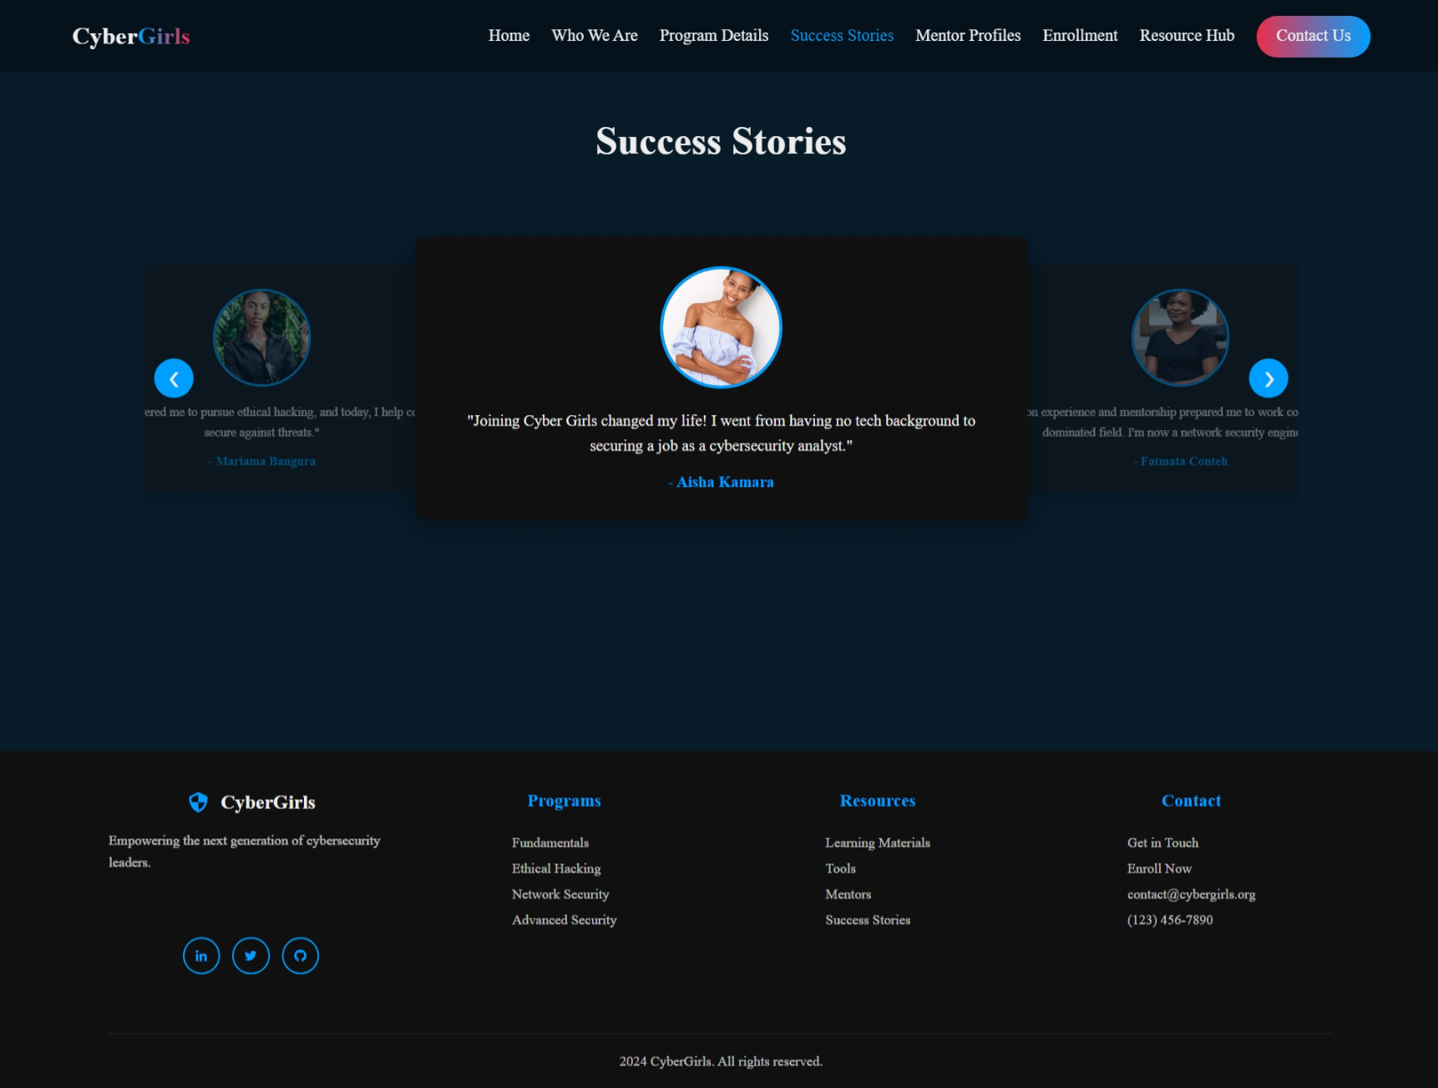
Stories Page
Stories Page - stories.html
Features inspiring success stories:
Student testimonials sharing their journey
Achievements and highlights
Real-life impact stories showcasing program effectiveness
Designed to build trust and motivate new participants

Slide 14
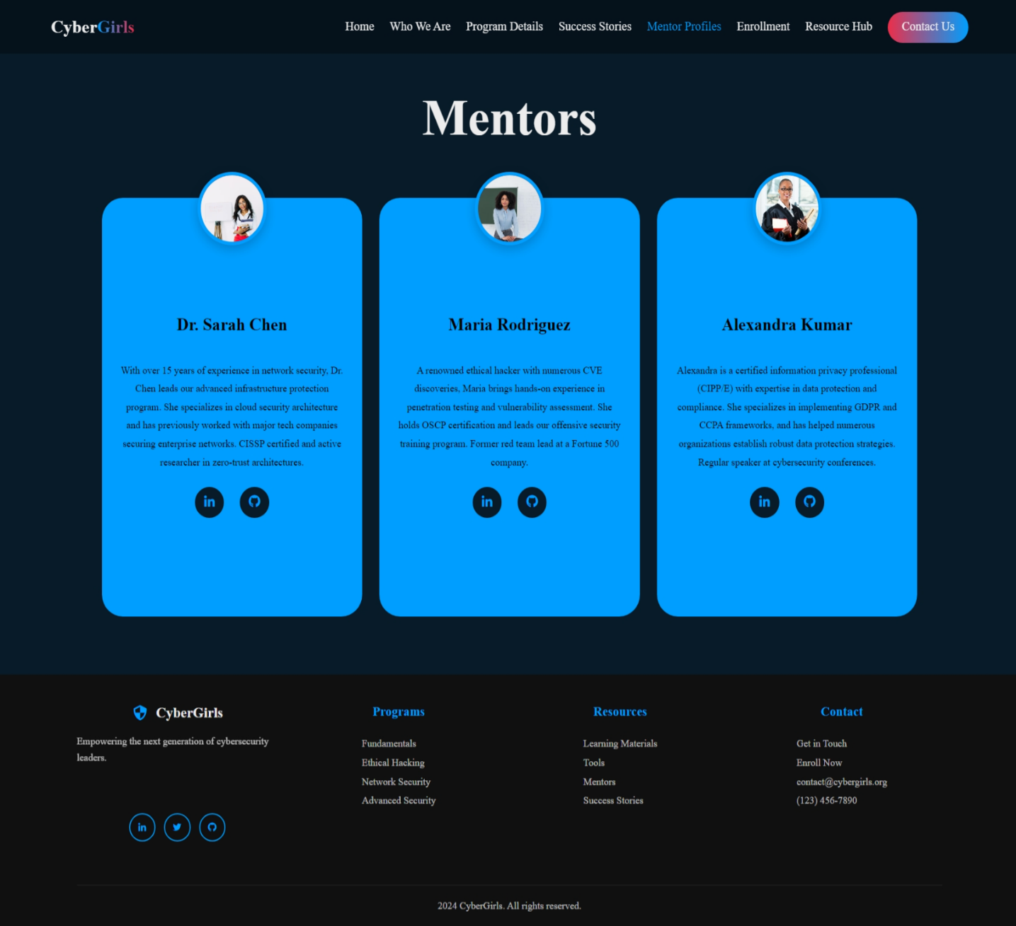
Mentors Page
Mentors Page - mentors.html
Dedicated to showcasing mentor profiles:
Information about their expertise
Professional backgrounds
Areas of contribution and mentorship approach
Highlights the strength and credibility of the teaching team.

Slide 15
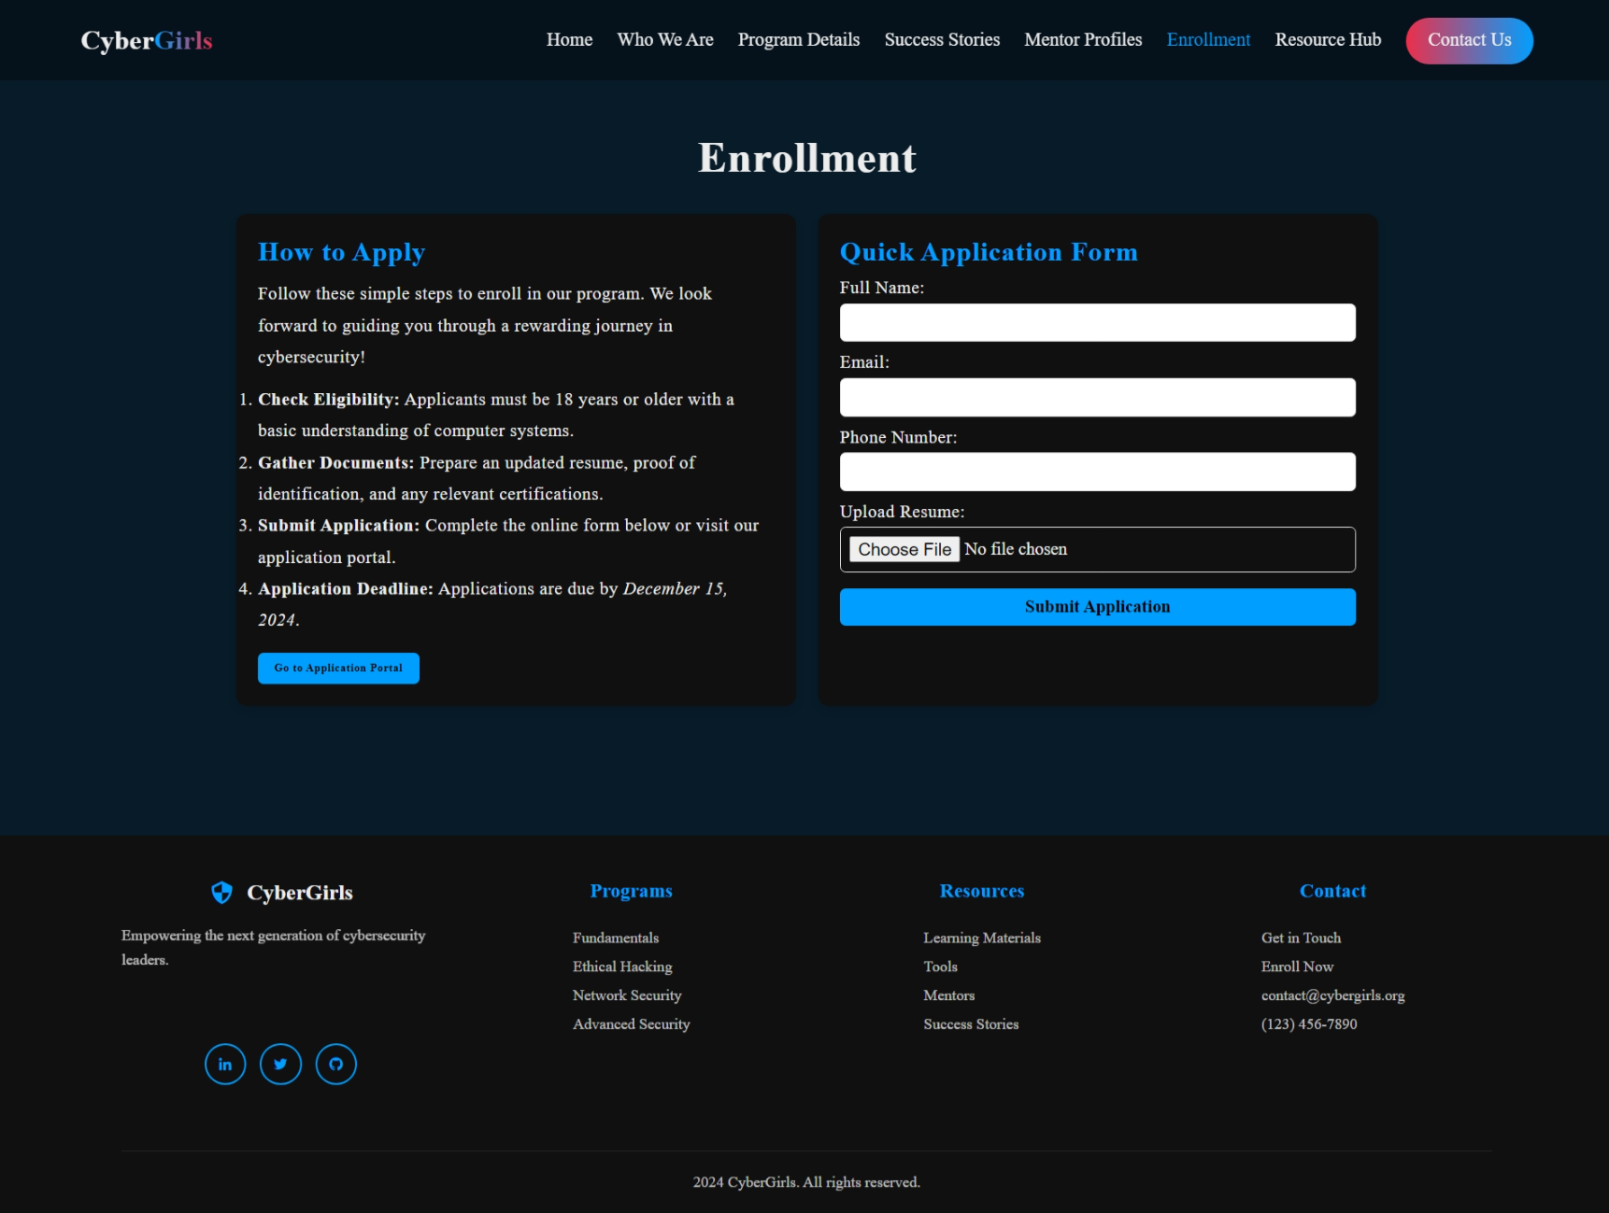
Enrollment Page
Enrollment Page - enrollment.html
Facilitates an easy registration process with:
Program selection and enrollment form
Step-by-step application guidance
Ensures a seamless user experience for onboarding participants.

Slide 16
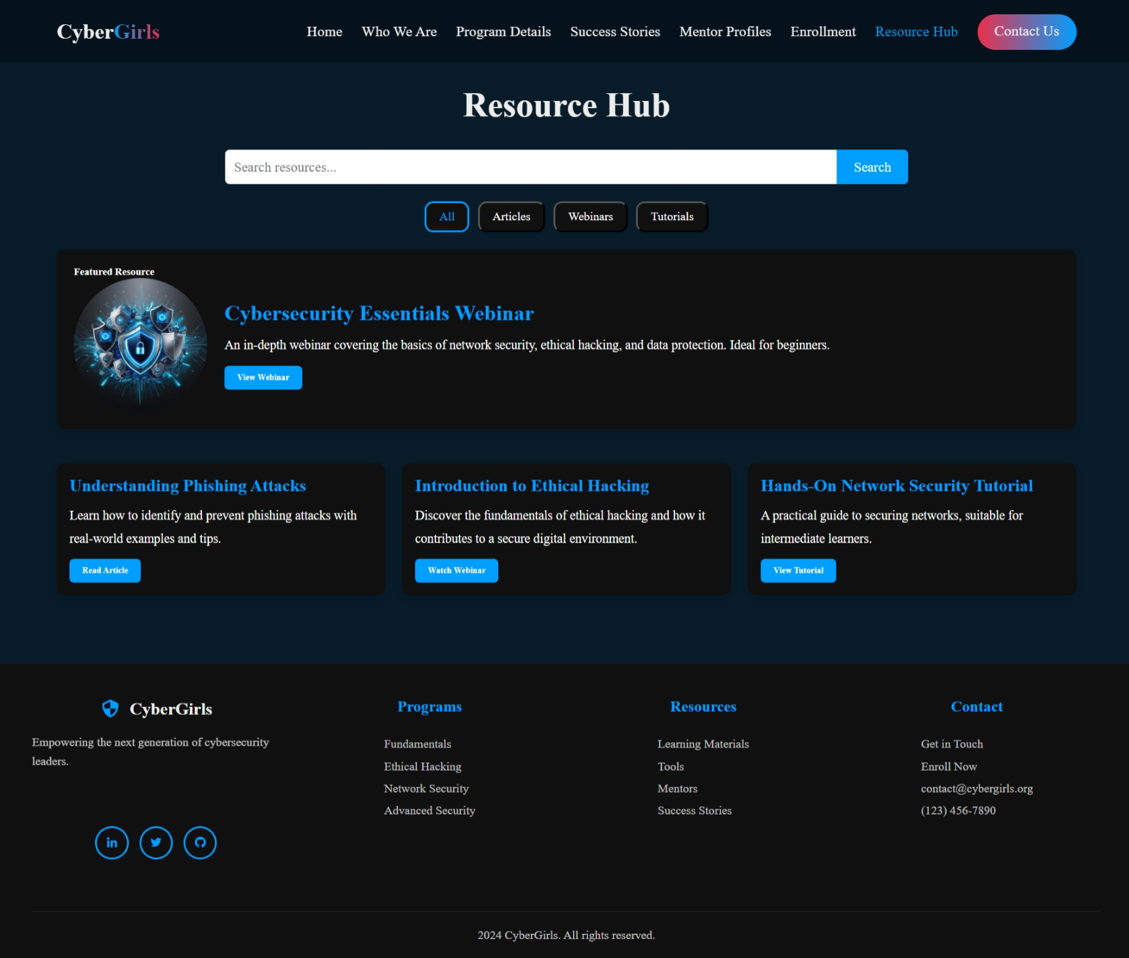
Resources Page
Resources Page - resources.html
Centralized resource hub for:
Learning materials like guides and videos
Tools and reference links
Additional educational content to supplement courses
Encourages self-paced learning and skill development.

Slide 17
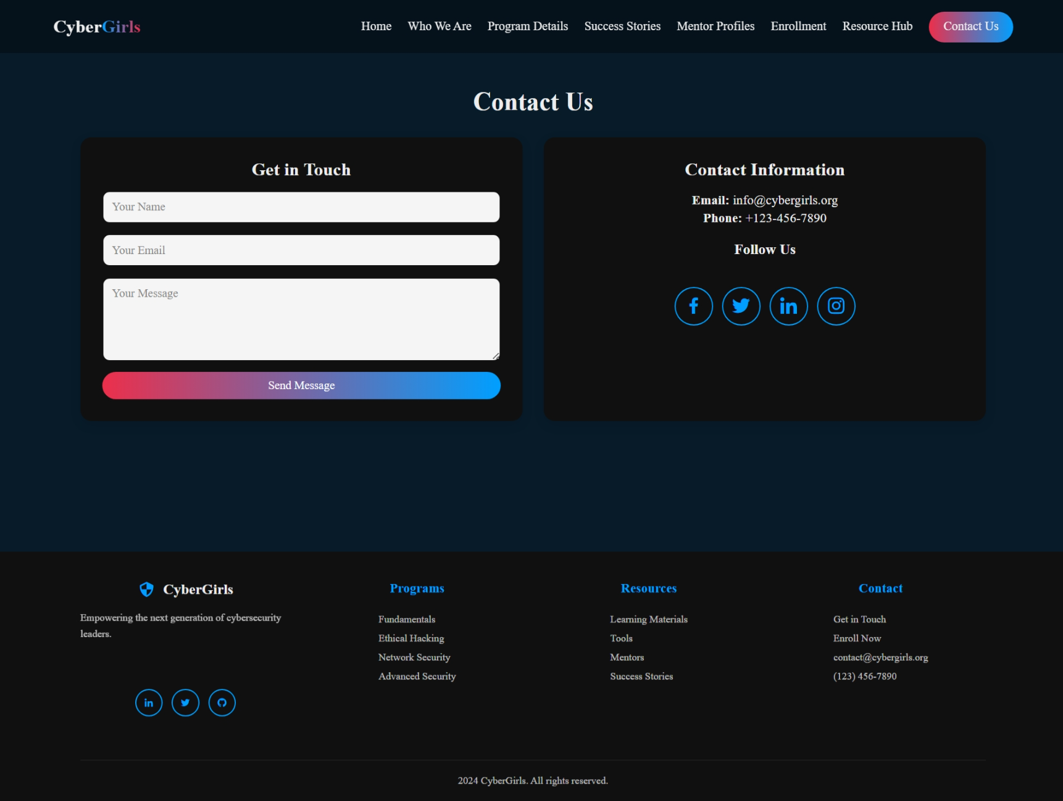
Contact Page
Contact Page - contact.html
Provides clear contact options with:
Organization’s address, email, and phone number
Get in touch form for inquiries
Social media integration for wider reach
Builds accessibility and engagement with the audience.

Slide 18





Key Takeaways and Next Steps
Modern Design
The CyberGirls website showcases a modern, modular approach to web design, prioritizing a clean, user-friendly experience.
Responsive Design
The website is fully responsive, adapting to various screen sizes and devices, ensuring accessibility and optimal user experience.
Technical Structure
The technical structure is optimized for performance and maintainability, utilizing vanilla technologies and a well-organized codebase.
Future Improvements
Future improvements may include modularizing the CSS for better organization and scalability, expanding the content and functionality, and incorporating user feedback.

